Slide 1
The Phoenix Award
Presented by Children’s Literature
Association

Slide 2
The Phoenix Award
Presented by Children’s Literature Association
Notes:
Books originally published 20 years ago- still influencing readers

Slide 3
The Phoenix Award
…“rise from the ashes of neglect and obscurity and once again touch the imaginations and enrich the lives of those who read them.”
….ChLA
Sculpture design by Diane Davis from
This drawing by Trina Schart Hyman
Notes:
Caldecott-winning illustrator Trina Schart Hyman The year is cast on each statue

Slide 4
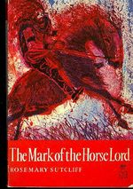
The Phoenix Award Beginnings
Originated from the Children’s Literature Association's Touchstones Committee 1985
intended to recognize books of high literary merit, originally published in the English language
Rosemary Sutcliff©1965
Notes:
Phoenix award committee 5 elected members serve 3yr each currently 2 from Georgetown University

Slide 5
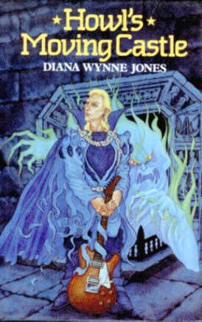
The Phoenix Award winners
2007
1997
2000
2010
Notes:
Isis 2000 howl’s 2006 Sutcliff (2nd) 2010

Slide 6
The Phoenix Award Honors
First honors 1989
Brother, Can You Spare a
Dime?
Milton Meltzer, 1969;
and
Pistol
Adrienne Richard 1969;
Double honor awards presented 1989, 1990, 1991, 1994, 1998, 1999, 2006
Honors not given some years
Notes:
Honors not given every year at least 7 years have had double honors awards

Slide 7
Works Cited
http://www.childlitassn.org/
phoenix_award.html
http://www.childlitassn.org/
phoenix_papers/2000AwardHughes[1].pdf
http://www.amazon.com/books

